Slide 1
Risk Factor Categorization from SEC Filings
Richard Albright
CSE-6748
Summer 2021
ralbright7@gatech.edu
GTID: 903548616

Slide 2
Risk Factor Categorization from SEC Filings
Employer Website https://www.infilings.com
Companies disclose risks to their business on a quarterly basis
These risks are not required to be categorized.
How do we compare one company’s risks to another?

Slide 3
Risk Factor Disclosure History
In 2005, the Securities and Exchange Commission required significant risk factors to be disclosed in a Company’s financial filings.
Companies must make a full risk disclosure annually as part of their 10-K filings (Forms 10-K, 10-KT).
Companies must report new and changed risk disclosures quarterly in their 10-Q filings (Forms 10-Q, 10-QT).
Companies making an Initial Public Offering must disclose risks in their registration statement (Forms S-1, S-1/A, 424B4).

Slide 4
Size and Scope of the Data Set
Analyze 10-K, 10-KT, 10-Q, 10-QT, S-1, S-1/A, 424B4 filings
Filings span from 2012 until 2020
254,837 Filings
3,764,242 Risk Disclosures
12.3 Gigabytes of Data (and that’s only Risk Disclosures!)

Slide 5
Processing the Data
We don’t have categories yet.
Analysts would need to manually review and tag every filing
There’s just too much data to reasonably construct history with the resources available
We can automate using Topic Modeling.
How do we get the data?
We have a REST API!
But does it work?
Where can it be improved?

Slide 6
Topic Modeling
Topic Modeling is a form of Natural Language Processing
What Model?
Latent Dirichlet allocation (LDA)
Word2Vec
Hybrid?

Slide 7
LDA
uses TF-IDF (term frequency – inverse document frequency)
Reduces arbitrary lengths of word lists to fixed numeric arrays
Only recognizes words it has seen before

Slide 8
Word2Vec
Neural Network Algorithm to learn word associations
Can detect synonyms of words
Can suggest words from a fragment of text
Each word is mapped to a number in a vector
2 Types: continuous bag of words or skip-gram

Slide 9
Hybrid Model
We want a fixed set of risk categories defined by subject matter experts that can be defined using LDA.
We also want the model to be flexible enough to guess at unknown words.
Enter the Fasttext Algorithm (modified word2vec algorithm)
Use LDA to train risk factor categories
Use the Fasttext Algorithm to create word vectors on the risk factor text and the risk factor categories
Many to one relationships allowed, a risk factor text can be assigned to multiple categories
Use cosine similarity to assign each risk factor text to its closest category
Not all risk factors need a category, set a cutoff on the probability prediction of unclear categories.

Slide 10
The Approach
Optimally we’d like somewhere between 50 and 100 risk categories that can be reduced to a broader set of topics.
Optimally run the LDA algorithm over a range of K topics and use the elbow method on the model’s Log Perplexity.
Hand the results of this model off to subject matter experts to tag a random sample of risk disclosures using the preset risk factor categories.
Run the LDA algorithm over each tagged category to generate a vector for that category.
Run the Fasttext algorithm on the category word vectors and the risk factor text
Use cosine similarity to determine which risk factor category the risk factor text is then assigned.

Slide 11
What can we do with the results?
We can create a risk profile based on the broader risk categories
Use page rank algorithm on those risk profiles to recommend companies with similar risk factors
We can weight the graph using each company’s Sharpe Ratio (measure of a company’s risk based on stock volatility)
Return the top X results to a client researching a particular company.
Does the risk profile match insider activity (SEC Form 4 Disclosures)?
Given enough time can we create an insider activity profile for each company as well and combine the 2 models?

Slide 12
Whats been done?
The external api has been tested and modified to make it easier for a client to use.
The api returns a filing in json format to make it easier for clients to process.
The text returned is in raw format and must be preprocessed
All filings have been preprocessed using the Spark-NLP library
Text has been split into sentences.
Dates have been normalized into a consistent format.
Sentences were then tokenized into words, normalized, lemmatized, then had their stop words removed.
Tokenized words were then used to form 2 and 3 word N-grams.
Certain N-grams were removed based on part of speech tagging.

Slide 13
Whats been done (continued)?
Overruled by management on finding the optimal number of topics.
An 80 topic LDA model was constructed as a first pass and handed off to the analysts (subject matter experts) to help them with category definitions.
1/3 of risk disclosure topics were financial in nature.
The initial results are in the hands of analysts to create the final risk factor categories and to tag a sample set with the categories they are developing.
Fasttext algorithm using cosine similarity to match to the LDA vectors was tested on a small sample from the initial cluster to verify the approach.
Working on company insider activity profiling while waiting for subject matter experts.
Insider Activity “Events” are broken into 5 categories – buybacks, management changes, positive events, negative events, research commentary
A profile is created over a lookback period based on counts of events in each category.
Tested Jaccard Similarity, cosine similarity, and Euclidean Distance as measures of similarity.
Euclidean Distance was determined to be the best measure of similarity for company insider activity profiles.

Slide 14
Timing Considerations
The time waiting for analysts to tag data is a HUGE variable.
The model may be built out using the original proposal of finding the optimal number of risk factors.
Use the unsupervised clusters as the model and build the rest of the project so the code is complete
The model can always be rerun when the final risk factor categories are determined.
The proof of concept would be complete, only the results would change.
The insider activity model is not the main focus of this project and may not be completed given the time considerations.
A combined model of risk factors and insider activity may not be completed given the time considerations.

Slide 15
What needs to be done?
Training the risk categories on a predetermined set of risk categories as determined by the analysts.
Create risk profiles based on the counts of risk factors across the yet to be determined broad risk factor categories.
Create a page rank algorithm using the risk factor categories to return companies that are most similar to a given company.
Create company insider activity profiles
Create a page rank algorithm for companies with similar insider activity.

Slide 16
Recommendations Made
The Rest API had some bugs that have since been addressed
Bulk mode for risk factors was non-existent, even though it is a wrapper function around another method that has a bulk mode, each filing was downloaded individually.
The Rest API has a bag of words mode that is not sufficient for the many different types of NLP that can be run on the data set. Recommend that we return results of multiple stages of the text preprocessing pipeline to clients.
The bag of words mode in the API is done strictly via Perl Regex. Possibly store the results of this project’s preprocessing and return those results instead.

Slide 17
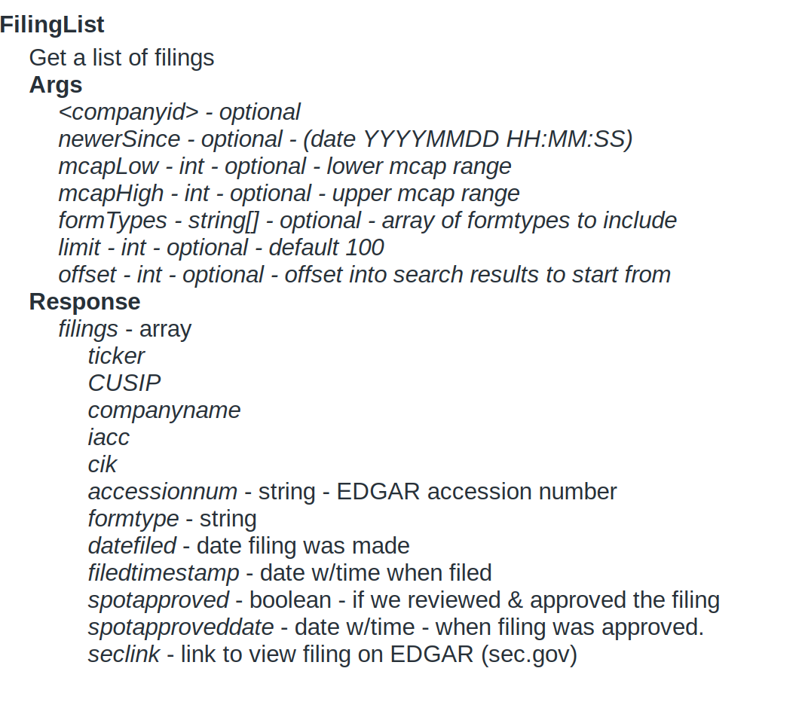
API Definitions

Slide 18
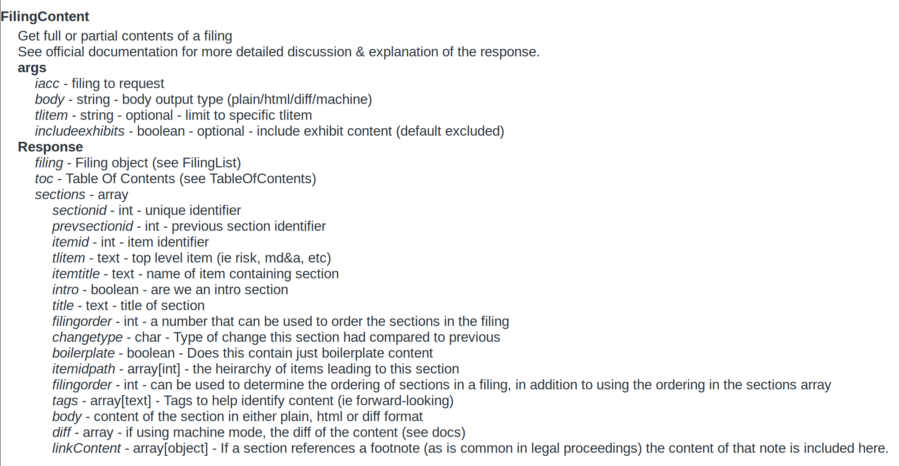
API Definitions (continued)

Slide 19
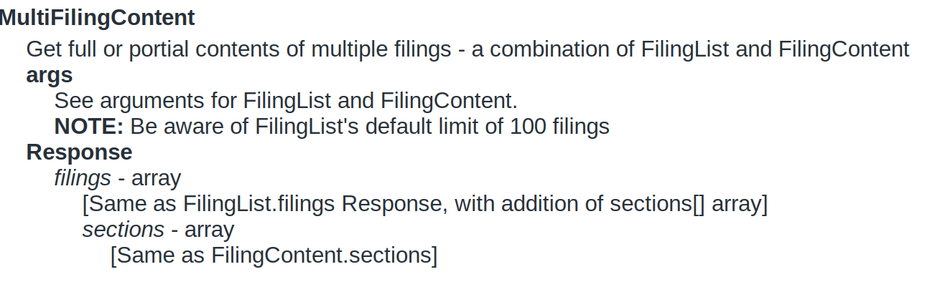
API Definitions (continued)

Slide 20
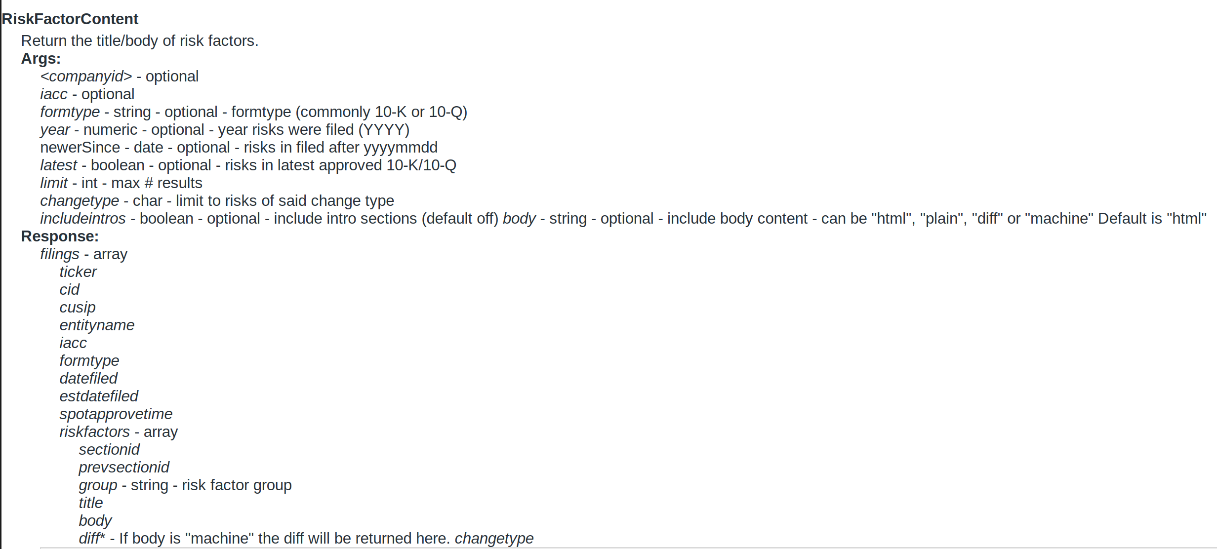
API Definitions (continued)

Slide 21
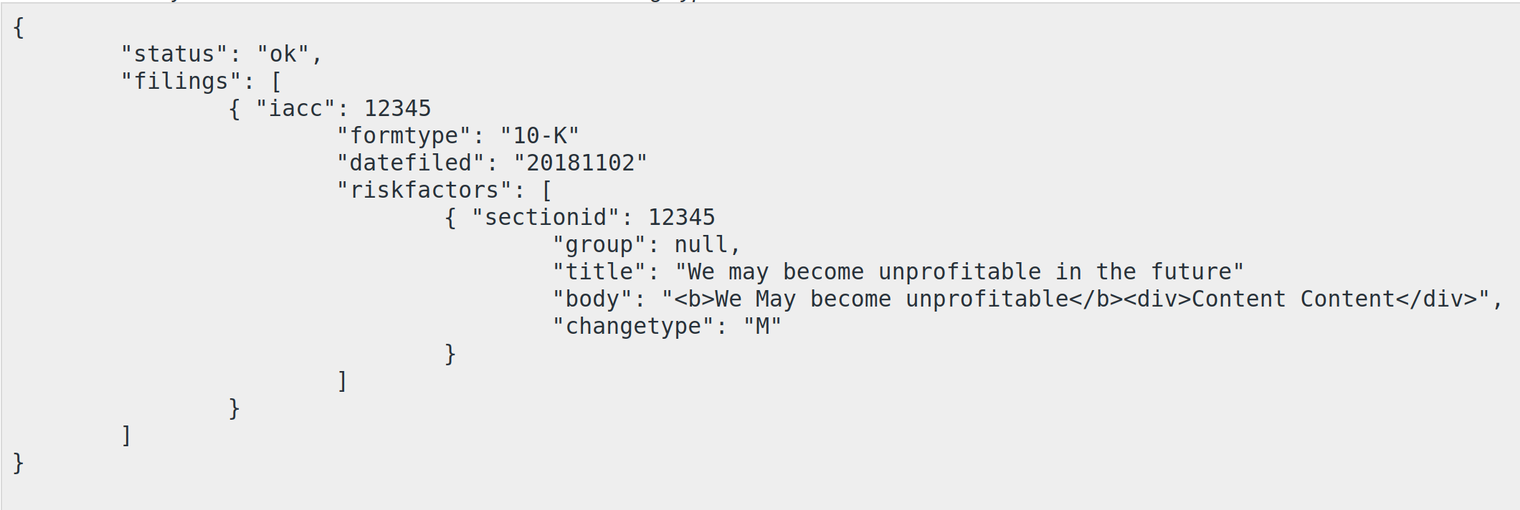
Risk Factor Json Results Sample

